Slide 1


MakerDAO y Monedas Estables
Kenton Prescott - 10/3/2018 - Mariano Conti - 10/18/2018
Notes:
Intro
Kenton Prescott
5th Year Aerospace Engineering
With a deep interest in software
Here to talk on Stablecoins and Makerdao

Slide 2
Agenda
Buen dinero
Problemas con la inestabilidad
MakerDAO
Dinámicas del Dai
Otros tipos de moneda estable
Métricas del Dai
El camino a seguir

Slide 3
El Estado de la comunidad Blockchain
Argumentos Morales
Argumentos Objetivos
?
Sin un punto único de falla
Descentralización
Confianza Cero
Accesibilidad
Resiste censura
Etc...
Redundancia
Liquidaciones rápidas
Mercados financieros eficientes
Ahorrar en costos
Etc...
Sin caminos únicos de confianza
Descubrimiento de precios
Ausencia de “cover” fees
Notes:
Bit fast because the good stuff is at the end
This is my attempt to remind everyone of the value of objectivism
Two umbrellas
Moral arguments
Trade efficiency
Left umbrella -> more concentrated in the right side
The right side is what drives profit-seeking businesses to adopt new tech
Keep this in mind as well go through the presentation

Slide 4
Teoría del Dinero según Aristóteles
Sí
Sí
Son estos activos dinero firme?
Bitcoin
Ethereum
Litecoin, etc
Sí
Sí
Sí
?
Valor Intrinseco
Durable
Divisible
Transferible
Criteria
Escaso
Fungible
Estabilidad Deseable
Notes:
Let’s start with how good money can be defined (A good transaction medium, and/or a good store of value)
In 350 BC, Aristotle defined the criteria for sound money -> apply to gold, precious metals, etc
His definition of intrinsically valuable is usually expanded in scarcity and fungibility
Ask the question
My own opinion is that we should include a 6th criteria, which measures the level of stability relative to a quote

Slide 5
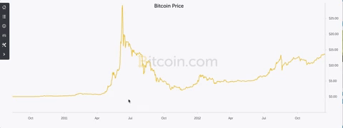
Estable relativo a una moneda global (USD) ?
Notes:
Describe graph

Slide 6





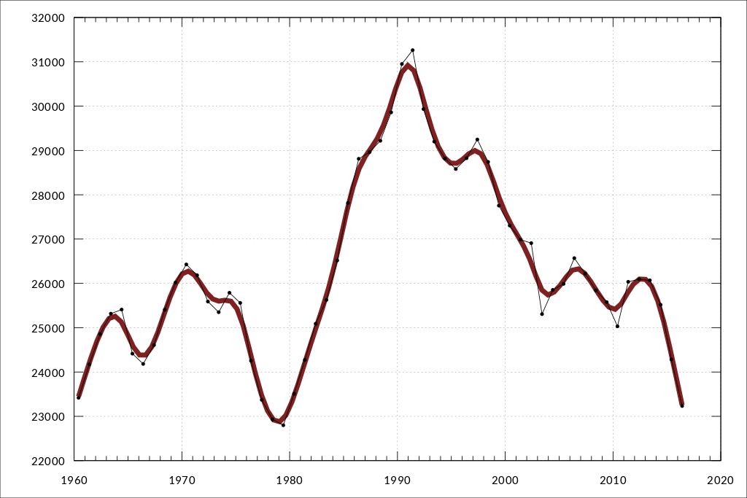



Problemas con la inestabilidad
Pagos
Contratos financieros
Dueño de Negocio
Clientes
Cripto-Activo [USD] vs Tiempo
Negocio A
Inversión
Bono, etc
Pago + intereses
Negocio B
Notes:
We can’t avoid the fact that USD is the global currency. It is always the last metric of wealth.
Explain examples

Slide 7
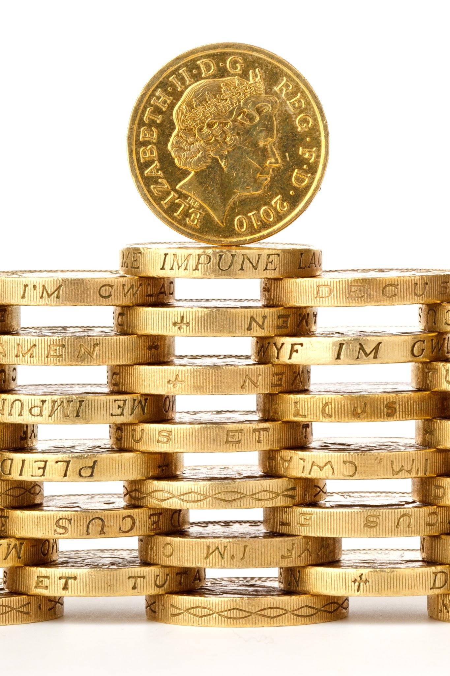
(una) Solución = Monedas Estables
Notes:
I tried to make this as climactic as possible
Now that you all understand some context, I’m going to touch on the mechanics of one of the oldest stablecoin projects in the space

Slide 8
Notes:
Makerdao
Started before the ethereum project was launched and set out to create the best stable coin
May be worth mentioning:
A stable coin needs key features
Decentralized
Fundamental stability that has been proven -> real assets and real value that backs the stable coin

Slide 9

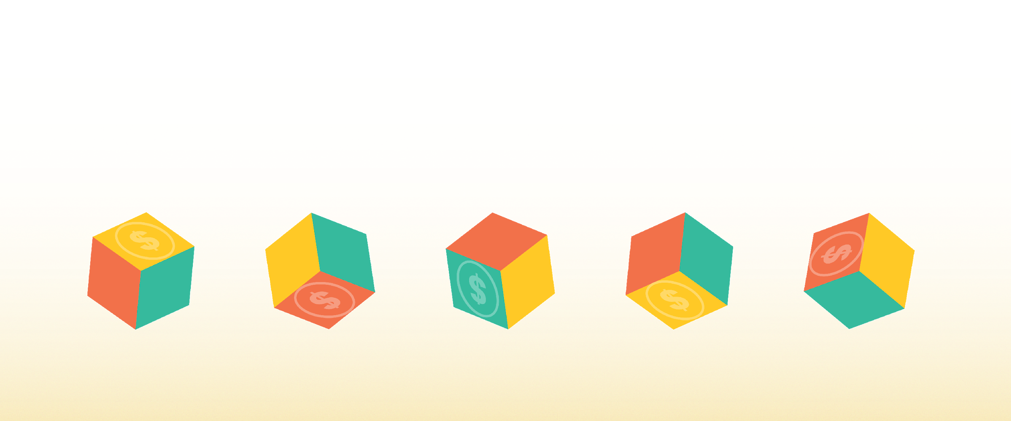
Conozcan a Maker
Desbloqueando el poder de la Blockchain para crear empoderamiento económico.
Notes:
Maker’s Mission is to unlock the power of the blockchain to create economic empowerment

Slide 10
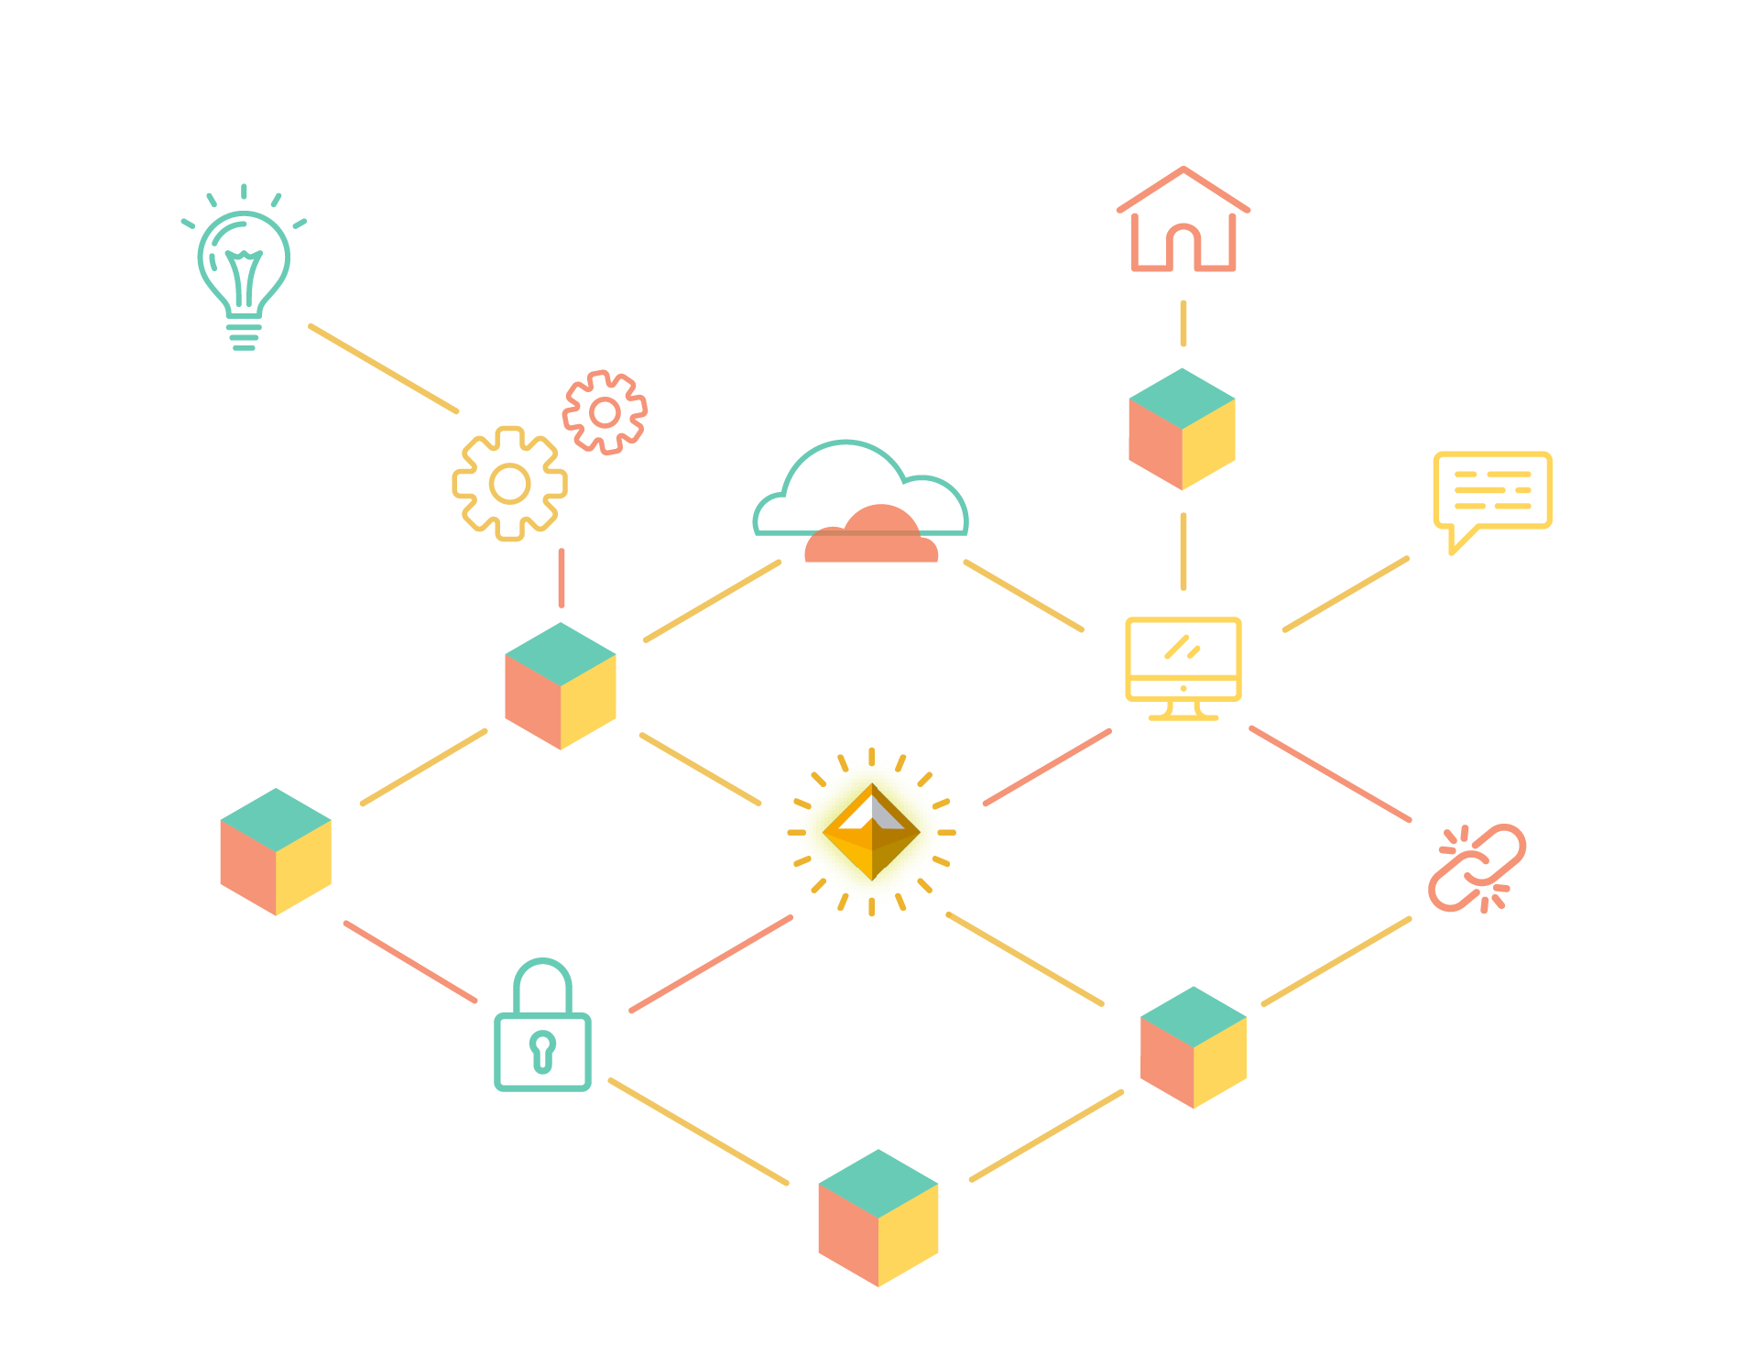
Una moneda estable es necesaria para la adopción masiva de criptomonedas.
Notes:
The next phase of the financial revolution will be unlocked when a decentralized, safe, secure stablecoin has achieved scale in the marketplace.

Slide 11
La moneda estable de Maker
DAI - Nuestro producto principal
Moneda respaldada por activos
Soft-pegged al USD
Usuario básico, el consumidor final
Fabrica de crédito sin permisos en los Contratos Inteligentes de Ethereum
Notes:
An attempt to create a stablecoin that has everything necessary to unlock the potential of blockchain.
Crypto asset ment for the end user
Crypto collateralized stablecoin
Stability is backed by a decentralized platform, and on this decentralized platform there are different types of collateral (ethereum, tokenized asset, such as digix gold), they are combined into a portfolio of assets that together back the stability of dai.

Slide 12
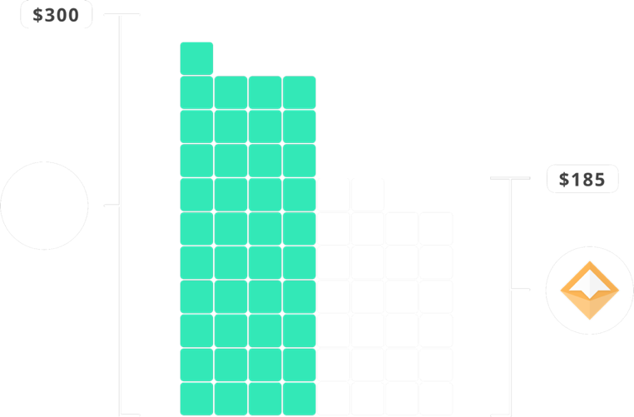
Dai - Mecánica
Posición de Deuda Colateralizada (CDP)
Pedir prestado Dai encerrando colateral en el sistema
Pagar deuda en Dai + interés para recuperar colateral
CDPs a salvo y sobrecolateralizados
Notes:
The second and third reasons one would interact with the Dai Credit System is via what we call a Collateralized Debt Position, or CDP for short. Both of these use cases are speculative and are dependent on the creator having faith in the future value increase of the asset they are depositing into the CDP.
Overcollateralization ensures that in event of a rapid decrease in asset price that a CDP can be liquidated with extra value to spare. This ensures that Dai holders can sleep well at night knowing that no matter what happens to the price of the asset backing their Dai that they can always receive equivalent value of the assets backing the Dai in circulation.
At the time of writing CDP’s were currently 370% over-collateralized.

Slide 13
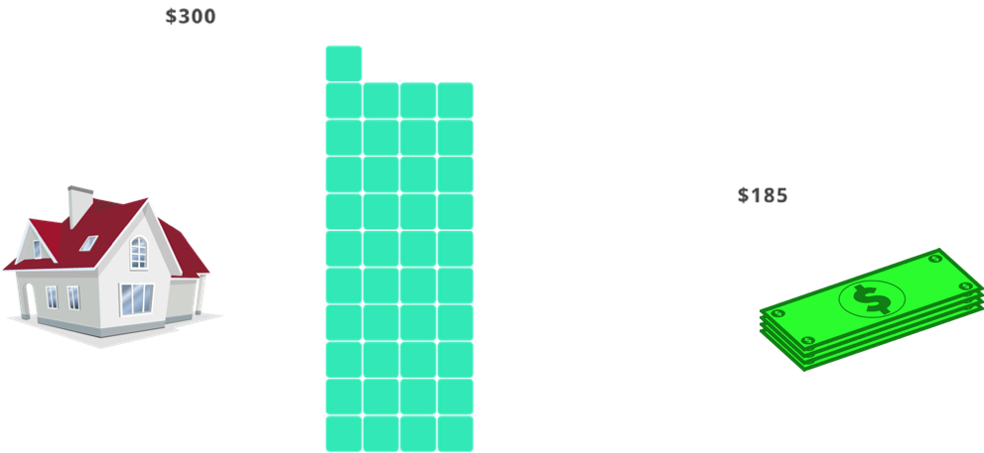
Dai - Mecánica
Análogo a una hipoteca
Pagar deuda + interés para “recuperar” la casa
Pedir prestado dinero con una hipoteca de un banco

Slide 14
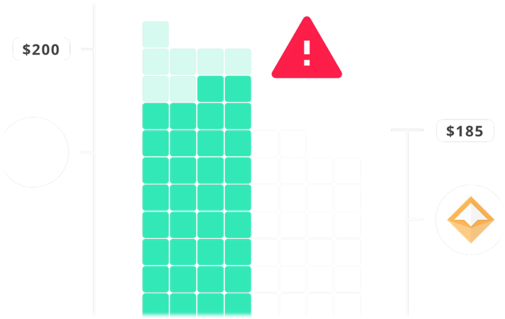
Dai - Mecánica
Liquidaciones
Un CDP se liquida si el precio del colateral baja demasiado
El colateral se vende en el mercado
Dueño del CDP recibe el colateral restante

Slide 15
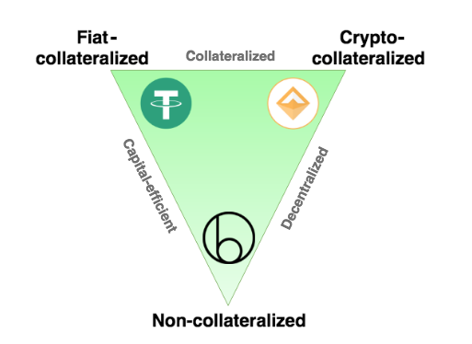
No todas las stablecoins son iguales
Te doy 1 stablecoin (IOU) por 1 dolar
Encerrar un cripto activo en un contrato inteligente y extraer moneda estable
Cantidad total de un token controlada por algoritmos
https://hackernoon.com/stablecoins-designing-a-price-stable-cryptocurrency-6bf24e2689e5
Notes:
Let’s take a quick look at the various forms of stable coin systems that are either planned or are in existence today:
Centralized:
IOU Model: (a token which is based on the principle of “when you give me fiat, then i give you a token which signifies that I owe you the redeemable value of that token”) Holders of the token need to trust a traditional, centralized organization or a legal agreement.
Decentralized & enabled by smart contracts:
Seigniorage shares model: Trust that the future value of the underlying bonds always increases, the economics incentives and structure are sound and that the smart contracts are secure.
Over-collateralized, Globally settleable Model: Trust the security of the smart contracts and the economic incentivizes and structure which ensure it’s stability.

Slide 16
Token de Gobernabilidad de Maker
MKR
Token de Gobernabilidad
Poseedores de MKR toman decisiones sobre cómo funciona el sistema Dai
Para usuarios avanzados
Notes:
Governance token that controls the platform that backs the dai stable coin
For the advanced user that wants to get into the advanced governance of a decentralized financial platform
Maker holders make the crucial decisions on what collaterals to allow into the system and on what terms.
E.g. ethereum should be more risky than tokenized gold, which is more risky than tokenized bonds
MKR is used for voting in new collateral types and it is also used to vote on the risk parameters associated with these collateral types.
It is also a necessary ingredient to close a CDP and is thus the fuel for the Dai Credit System

Slide 17
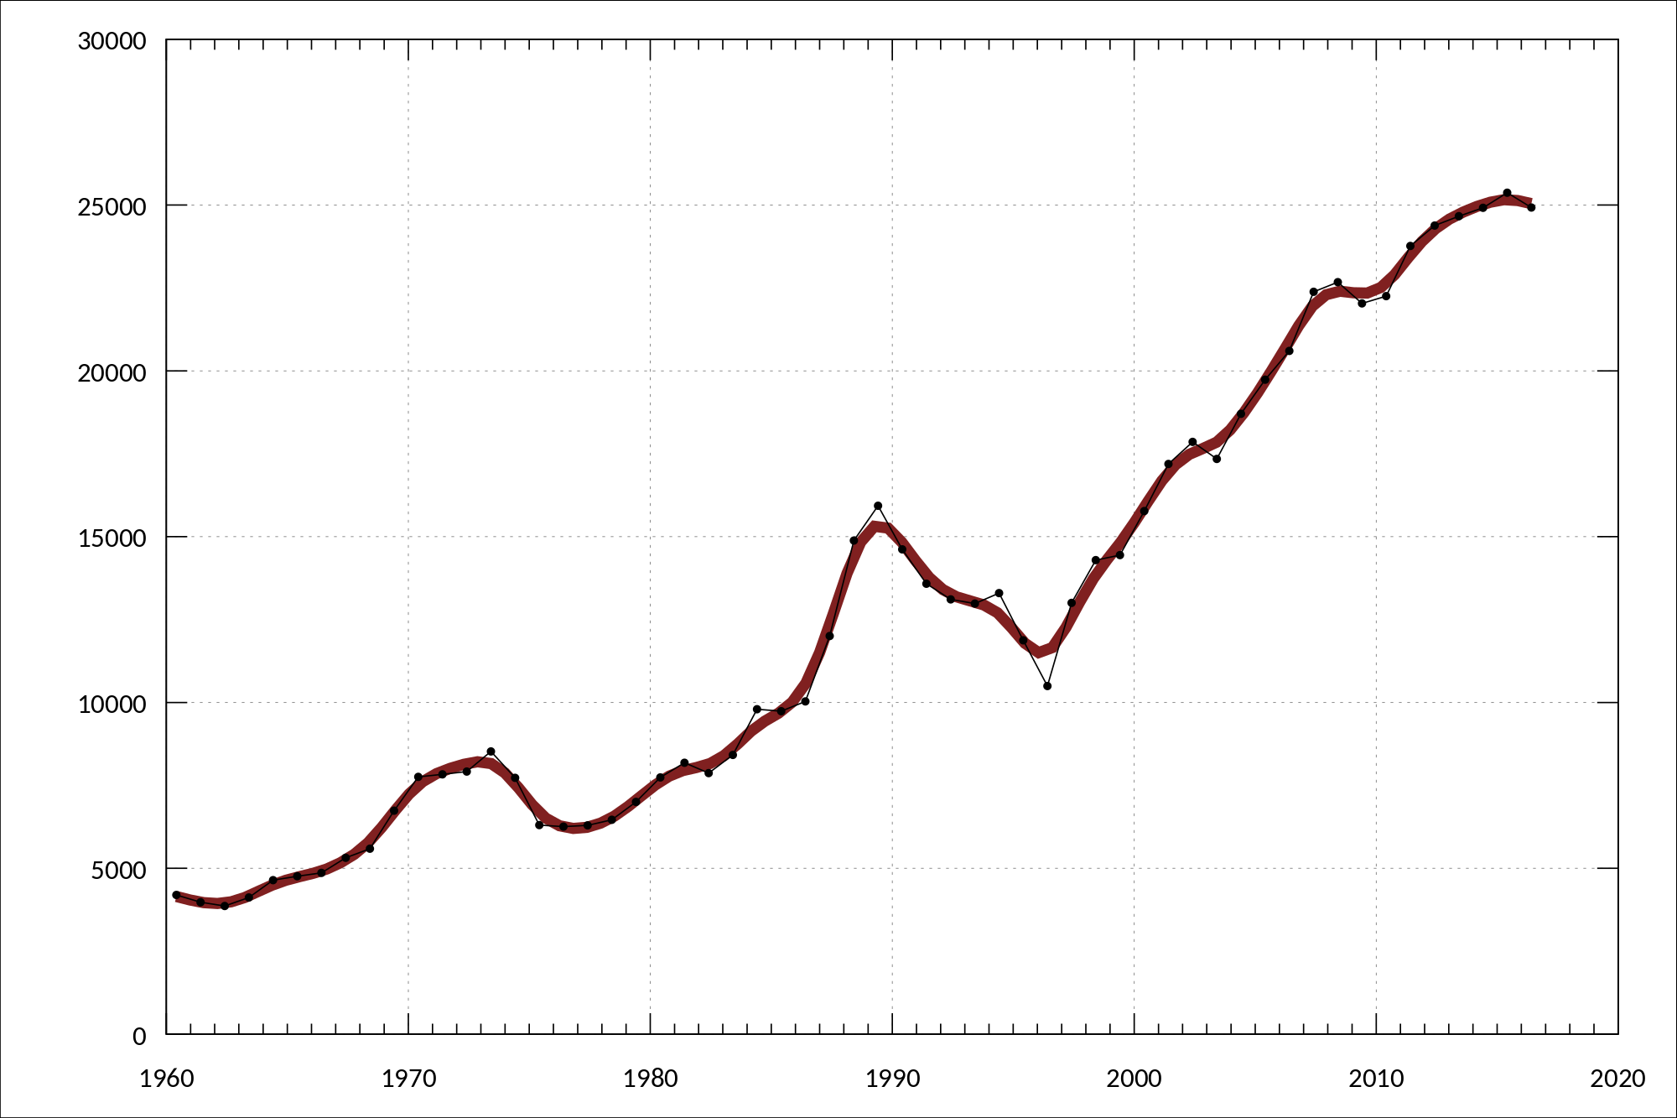

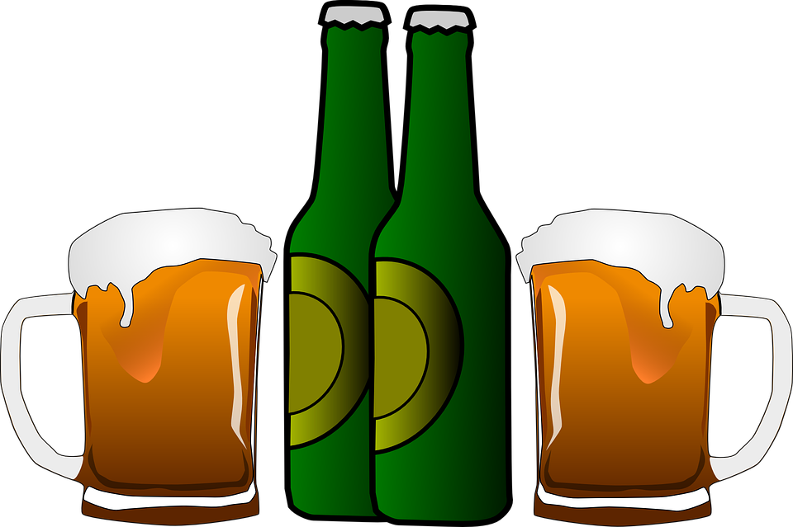
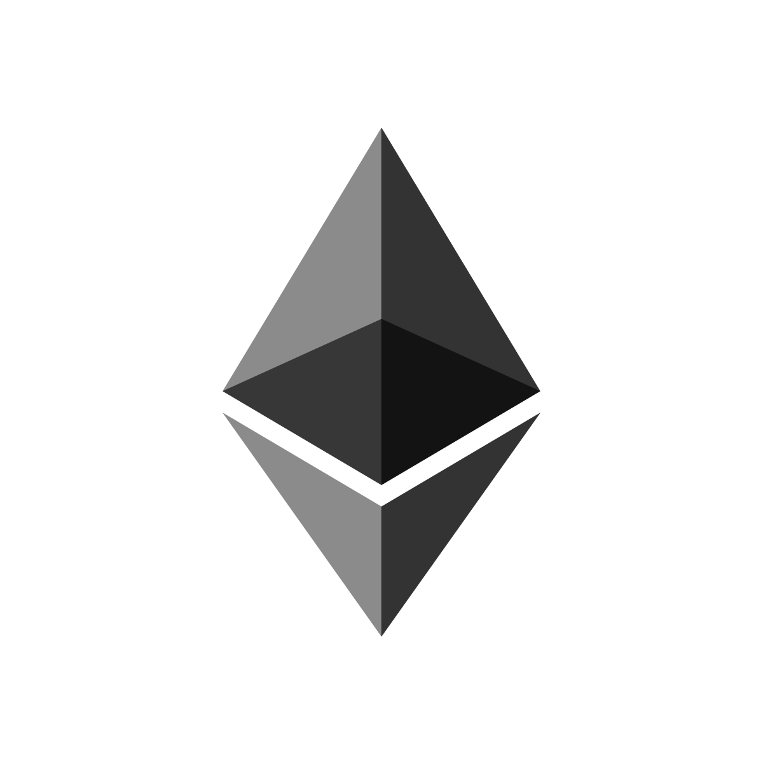
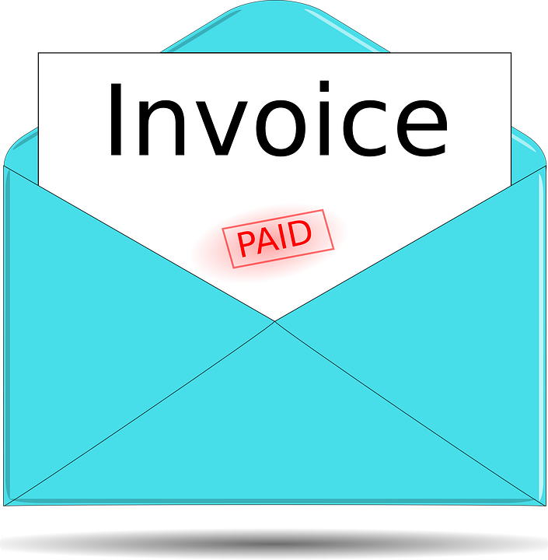

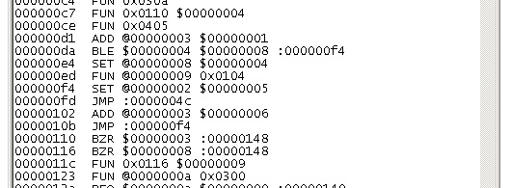

El Gran Diagrama de Flujo
Bob
CDP Engine
ETH [USD] vs tiempo
Ethereum Blockchain
MKR Holders

Slide 18

Funciones del Dai
Cadena de suministro
Préstamos
Remesas
Exchanges
Pagos/compras online
Margen descentralizado
Cobertura contra volatilidad
Mercados de predicción
Notes:
Any financial service or product can be imagined with the use of Dai

Slide 19
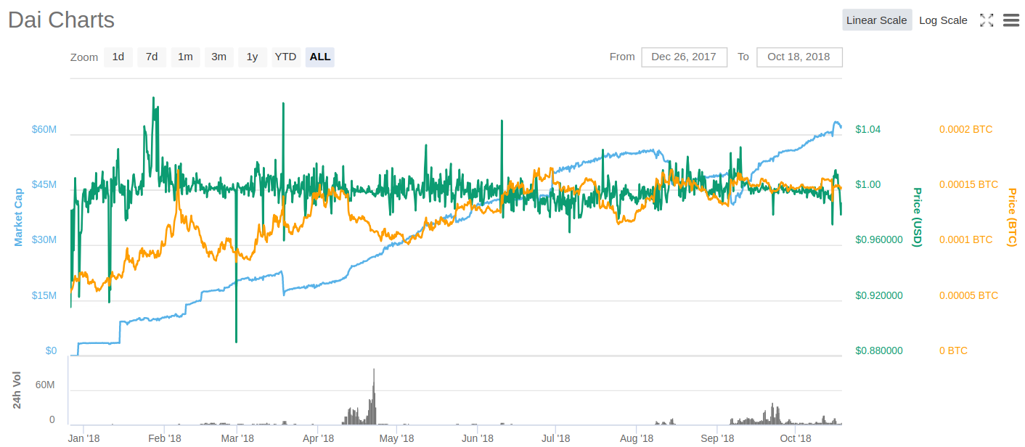
CDPs abiertos
2013 actual
3235 total
Dai creado
62,941,134 actual
137,075,350 total
Métricas del Dai
Notes:
Explain each colored chart

Slide 20
Una moneda estable duradera
Sobre colateralizadas:
Siempre hay más dinero respaldando el Dai que el Dai que existe en circulación.
Multi-colateral:
Resistencia ante los eventos “black swan”.
Notes:
To summarize, these are the methods that ensure the security and stability of multi collateral Dai:
Diversifed, uncorrelated collateral pool which is thus reslient in the face of black swans
Over collateralization and the threat of global settlement at any time ensure the stability of Dai.
Arbitrageurs provide liquidity at the peg because they know that the system can be shut down at any time and have exactly $1 worth of collateral returned to them.
The old instance of Dai is then rendered invalid and the holder is prompted to migrate to the new instance by redeeming the old instance

Slide 21
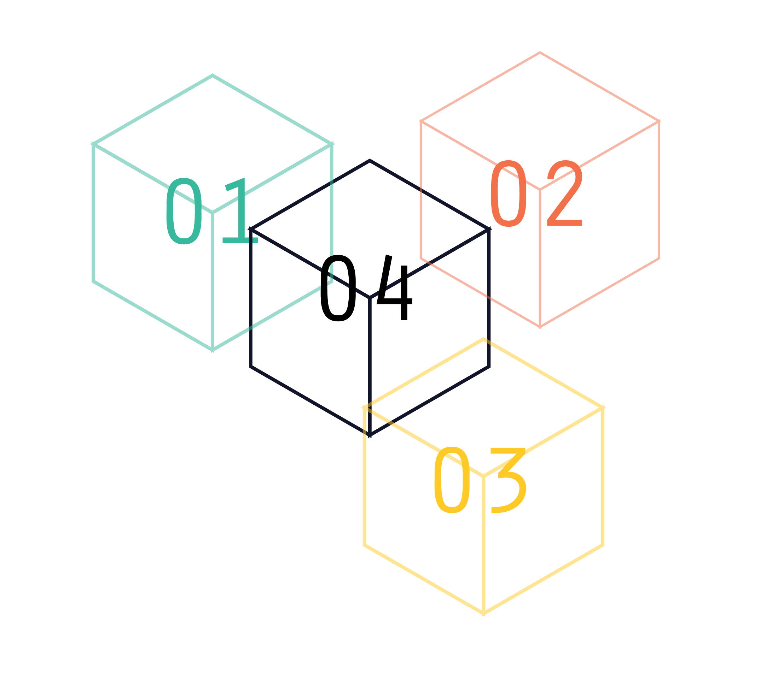
Una moneda estable duradera
Multi-colateral:
Resistencia ante los eventos “black swan”.
Notes:
The current version of Dai in the wild is single collateral which means that if a black swan were to occur and the price of ETH was to drop instantaneously across all exchanges at once to 0, then Dai would fail. The multi collateral version of Dai is due to be released in June will be resilient even in the face of such an event because the collateral pool will be diversified with non-correlated assets. This means that even if one collateral type fails completely that Dai holders would still be made whole because all CDPs in which the Dai were created are all over-collateralized.

Slide 22
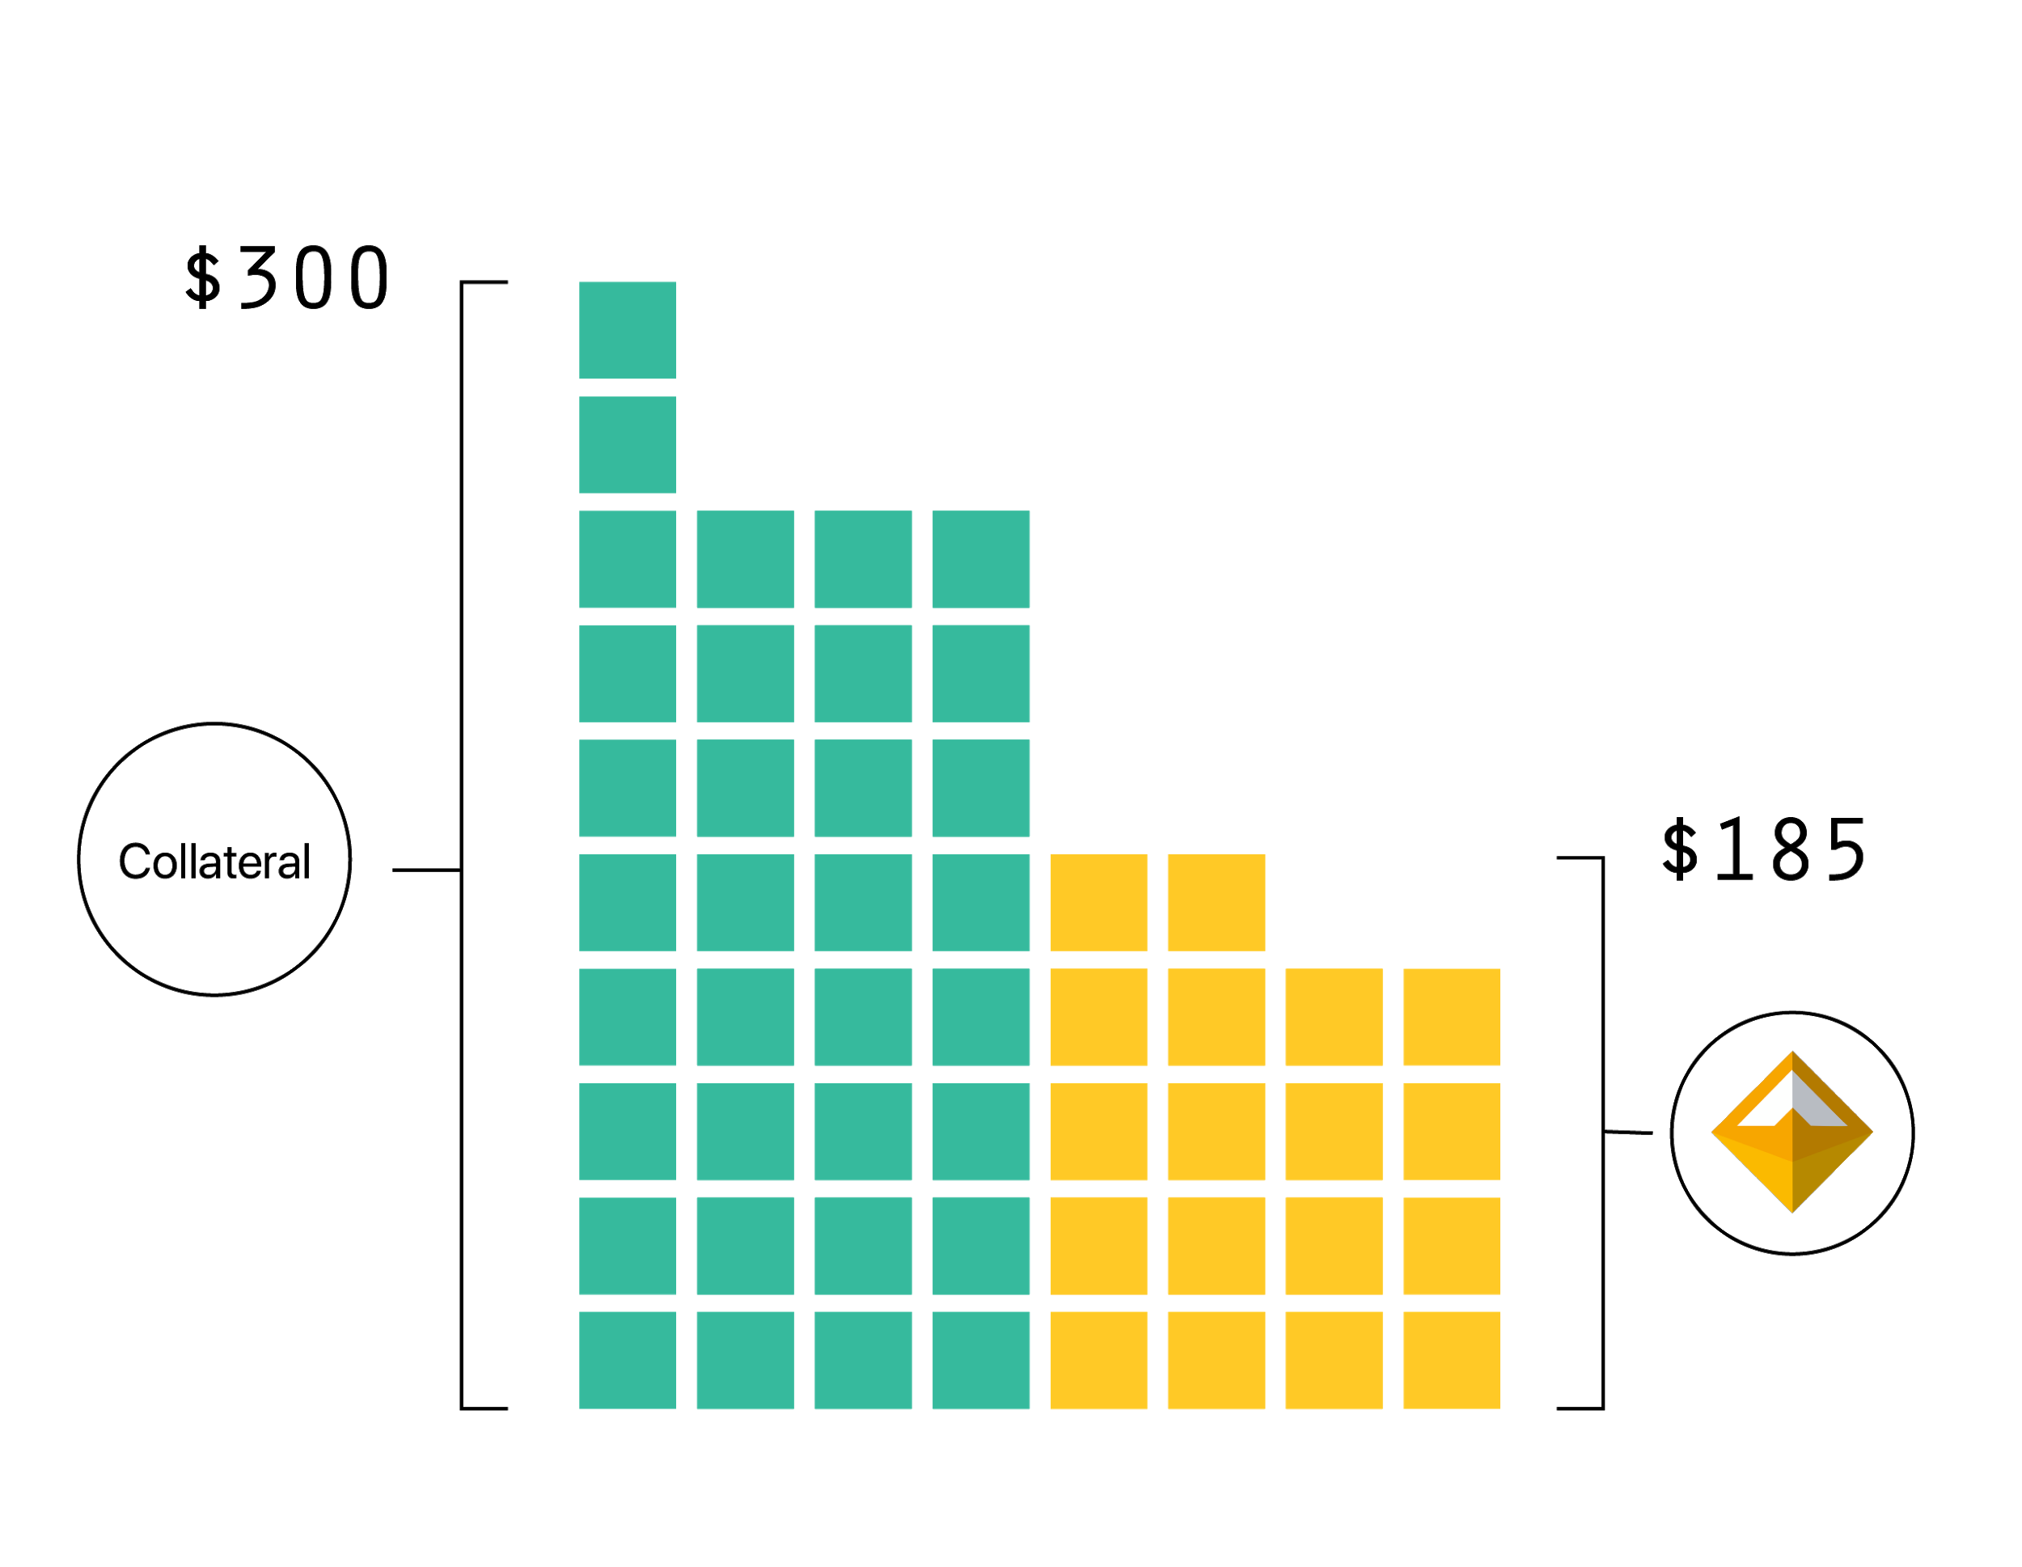
Una moneda estable duradera
Over collateralized:
Siempre hay más dinero respaldando el Dai que el Dai que existe en circulación.
Notes:
Overcollateralization ensures that in event of a rapid decrease in asset price that a CDP can be liquidated with extra value to spare. This ensures that Dai holders can sleep well at night knowing that no matter what happens to the price of the asset backing their Dai that they can always receive equivalent value of the assets backing the Dai in circulation.
At the time of writing CDP’s were currently 370% over-collateralized.

Slide 23
Línea de tiempo
Un colateral:
Ethereum
Múltiples colaterales:
Ethereum
Bonos
Bienes raíces
Facturas Tokenizadas
Multi-Collateral Dai (MCD)
Sai (Alpha)
Dai (Beta)
Diciembre 2016
Diciembre 2017
Fin de 2018 (actualmente en Kovan)

Slide 24
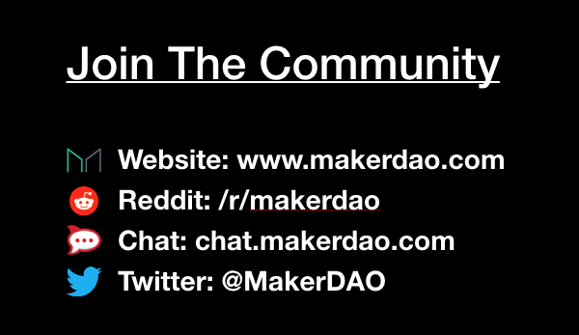
Súmense a nuestra comunidad

Slide 25
Muchas gracias!

